Slide 1


Green Pace
Security Policy Presentation
Developer: Chris Bridges
Notes:
Hi. My name is Chris Bridges, and today I’ll be presenting the Green Pace security policy. This presentation introduces the standards we follow to prevent vulnerabilities and protect our applications using industry-standard defense-in-depth strategies.

Slide 2

OVERVIEW: DEFENSE IN DEPTH
This security policy is a collection of standards and best practices to ensure the safety of our software and data. Many layers of defense in depth are integrated into this policy.
Notes:
This policy was created because, as our team grows here at Green Pace, so does the chance of being attacked. To ensure consistency and reliability, we must have a policy in place. We will follow a defense-in-depth strategy to ensure multiple layers of protection against various threats.

Slide 3
THREATS MATRIX
Low Priority: Low severity and unlikely to happen
Likely: Low severity and likely to happen
Unlikely: High severity and unlikely to happen
Priority: High severity and likely to happen
Likely STD-002-CPP STD-007-CPP | Priority STD-004-CPP STD-005-CPP
Low priority STD-001-CPP STD-006-CPP STD-009-CPP STD-010-CPP | Unlikely STD-003-CPP STD-008-CPP
Notes:
Our approach assumes that threats can exist anywhere. Input handling, memory access, or just misconfigurations. So. To manage these risks, we won’t wait until our products reach production. This slide ranks our security standards based on severity, likelihood, and remediation cost. For example, SQL Injection and Input Validation are marked as critical because they can lead to full database compromise. Unsafe string handling ranks high due to its frequency and real-world impact. Prioritizing this helps us focus on the highest risks first, improving both efficiency and protection

Slide 4

10 PRINCIPLES
1 | Validate input data | STD-004-CPP, STD-003-CPP, STD-004-CPP, STD-010-CPP
2 | Heed compiler warnings | STD-001-CPP, STD-002-CPP, STD-005-CPP, STD-009-CPP
3 | Architect and design for security policies | STD-006-CPP, STD-007-CPP, STD-008-CPP
4 | Keep it simple | All Standards
5 | Default deny | STD-008-CPP, STD-010-CPP
6 | Adhere to the principle of least privilege | STD-004-CPP
7 | Sanitize data sent to other systems | STD-004-CPP, STD-010-CPP
8 | Practice defense in depth | All Standards
9 | Use effective quality assurance | All Standards
10 | Adopt a secure coding standard | All Standards
Notes:
Our policy is governed by ten core security principles, including input validation, Default Deny, and Defense-in-Depth. Each coding standard is mapped back to these principles to ensure our rules are not arbitrary; they’re aligned with proven industry guidance. For instance, input validation supports both SQL Injection defenses and String Safety. Defense-in-Depth supports every standard by ensuring overlapping protections when one control fails.

Slide 5
CODING STANDARDS (Ranked in order of priority)
1 | STD-004-CPP | SQL Injection: Query safe and prepared statements
2 | STD-010-CPP | Input Validation: Guard against invalid input
3 | STD-003-CPP | String Correctness: Replace unsafe strings
4 | STD-005-CPP | Memory Protection: Smart pointers, leak prevention
5 | STD-007-CPP | Exception Safety: Catch by reference, noexcept destructors
6 | STD-009-CPP | Pointer Safety: No dangling stack pointers
7 | STD-002-CPP | Data Value Ranges: Prevent overflow with range checks
8 | STD-001-CPP | Data Types: Use fixed width types
9 | STD-008-CPP | Secure Logging: Hide passwords and tokens in logs
10 | STD-006-CPP | Assertions: Internal logic integrity and defense
Notes:
We ranked our standards by real-world exploitability. Priority goes to SQL Injection and Input Validation because they’re directly involved in major breaches. Next, we address String Safety and Memory Protection, which can lead to crashes and remote code execution. Lower-risk areas like logging and assertions are still important, but they don’t pose the same threat level. This prioritization ensures we reduce the most dangerous security problems first.

Slide 6
ENCRYPTION POLICIES
Encryption ensures data safety!
In Flight – All data transmitted between services should use TLS. Certificates should be validated; no self-signed certifications. HTTPS should be used on all public endpoints. These minimize the risk of man-in-the-middle attacks and session hijacking.
At Rest – Databases and backups should use AES-256 encryption. Access to stored data should follow least privilege, role-based access controls (RBAC). This prevents unauthorized file access and theft.
In Use – Sensative variables should be cleared after use. Sensitive information should not remain in memory or logs. Protects against runtime exploits and memory scraping.
Notes:
Encryption is enforced at three levels. In Flight, we require TLS to prevent interception. At Rest, we use AES-256 with key management and access control. In Use, we prevent sensitive values from lingering in memory where they could be exposed in runtime attacks. By covering data in every state, in motion, at rest, and in use, we maintain continuous protection against data theft or manipulation.

Slide 7
TRIPLE-A POLICIES
Authentication, Authorization, and Accounting
Authentication verifies identity. All users must prove identity using multi-factor authentication or secure tokens.
Authorization enforces least privilege. RBAC should be used to ensure sensitive data is kept private. By default, access should be denied.
Accounting ensures proper tracking and logs are in place. All security-related events (logins, permission changes, data access) must be logged. Logs must be tamper-evident, time stamped, and stored centrally. Must support compliance investigations and have a retention policy.
Notes:
The Triple-A framework ensures complete access control and accountability. Authentication verifies identity using MFA and unique credentials. Authorization enforces least privilege. No developer or service receives more access than required. Accounting logs every security-related action, from database changes to login attempts, enabling traceability and compliance. Together, these controls ensure we always know who did what and when.

Slide 8
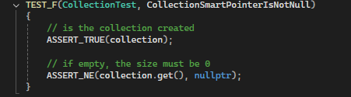
Unit Testing (Null Pointer)
Notes:
To validate our policies in real-world development, we applied unit testing to support the standards. We tested how our code handles vectors, null inputs, capacity growth, and memory cleanup. These tests confirm that our codebase safely manages dynamic memory without leaks or undefined behavior. In this first test, we simulate a null pointer or an uninitialized vector access. The goal is to ensure our code responds with a controlled failure or rejection, instead of crashing. By validating how our functions react to invalid states, we verify a safe failure, rather than a crash.

Slide 9
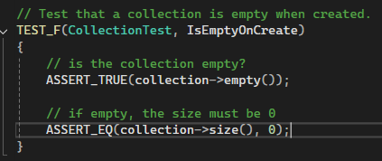
Unit Testing (Is empty on create)
Notes:
This test checks that a vector starts with no undefined content. An empty container must start in a clean, safe state. If the vector returns unexpected values, it means we have memory trash. Dangerous leftovers can expose previous data, including sensitive information.

Slide 10
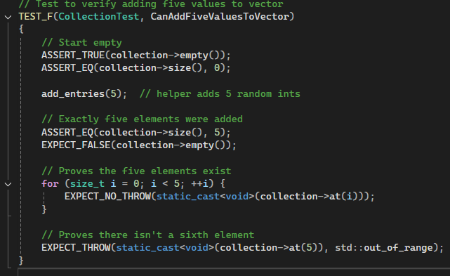
Unit Testing (Can add 5 values to the vector)
Notes:
Here, we test controlled memory growth by inserting multiple values. We’re verifying correct logic and dynamic allocation. Ensuring that capacity growth is handled safely. If insertion fails or corrupts adjacent memory, it indicates unsafe allocation practices.

Slide 11
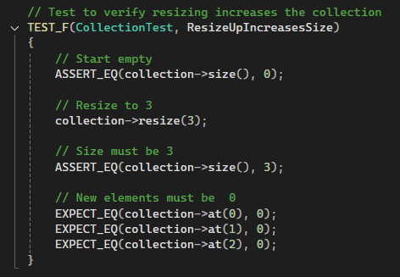
Unit Testing (Resizing increases collection)
Notes:
In this test, we resize the vector and confirm that data is retained and memory integrity remains stable. This represents safe memory reallocation. Secure code must handle capacity changes without corruption, leaks, or invalid index access.

Slide 12
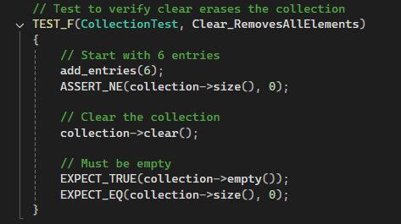
Unit Testing (Clear removes all elements)
Notes:
In our last example, we ensure that calling ‘clear’ truly resets the container and does not leave data behind. This aligns with memory management. Sensitive data must be fully removed when no longer needed. If data persists after clear, a privacy risk exists.

Slide 13

AUTOMATION SUMMARY
DevSecOps ensures you create the most secure application possible, and automation helps achieve this.
These policies should be used during the DevSecOps development process.
Notes:
This slide shows how our policy integrates into the DevSecOps pipeline. We won't wait for the release to perform security testing. We automate security checks during coding, building, and testing. Tools like clang-tidy and Cppcheck help us block insecure code before it reaches production. This creates continuous assurance, not a post-release patch.

Slide 14
TOOLS
The DevSecOps pipeline diagram shows how security is integrated through each of the steps of a development cycle.
Pre-production highlights the steps for designing and testing software
Production shows the steps for deploying, maintaining, and monitoring the application.
Design stage – Uses security policy and OWASP for creating a secure design.
Build stage – Use an IDE for compiling the secure code.
Verify and test stage – Static analysis and unit testing.
Transition and health check – pen testing, configurations, and security settings
Monitor and detect stage – Logging events and implementing monitoring tools.
Respond – Respond to threats by blocking attacks, updating frameworks, or rolling back services
Maintain and stabilize – Return to a stable state after an attack
Assess and plan – assess new threats and adjust accordingly
Notes:
This slide illustrates how our security tools support every phase of the DevSecOps pipeline. In the Design stage, we use our security policy and OWASP guidelines to prevent vulnerabilities early. During Build and Verify, compilers, static analysis, and unit tests catch coding issues like memory errors or unsafe input. Before release, Health Checks and Pen Testing validate configurations and dependency safety. Once deployed, Monitoring tools track logs and alerts for suspicious behavior. If an issue occurs, Response tools allow rollback or blocking actions, followed by stabilization and review. By integrating tools across all stages, security becomes continuous, not just a final check.

Slide 15
RISKS AND BENEFITS
Security should be integrated throughout the entire process.
Risks
Waiting can result in additional resources and reworking entire code bases.
Liability if breached and no security measures taken
Costs the company and customers time and money with poor security
Benefits
Better code
Easier to implement code as developed than adding later
Reliability
Professionalism
Secure code functions better, malicious attack or not.
Notes:
The biggest risk isn't having vulnerabilities; it’s delaying a response to them. The longer we wait to implement these standards, the more challenging it becomes. Early adoption saves costs, strengthens reliability, and improves our productivity.

Slide 16
RECOMMENDATIONS
Training for developers to implement the new security policy.
Cybersecurity consultants can test for new and emerging threats.
Ensure developers are using DevSecOps methods.
Automated vulnerabilities monitoring
Notes:
To strengthen our security, I recommend investing in ongoing developer training so everyone applies the policy in all projects. We should also bring in cybersecurity experts periodically to identify new and emerging threats that may be unknown to us. Enforcing DevSecOps practices will ensure that security is built into every stage of development, not added at the end. Finally, automated vulnerability monitoring will help us detect risks early.

Slide 17
CONCLUSIONS
This security policy should be updated and reviewed regularly to ensure new and emerging threats are considered.
Training on this policy and DevSecOps should be implemented to ensure proper adoption.
Code that has not been thoroughly tested and debugged should not go into production.
Security must be integrated throughout the development lifecycle. From the design process through to production.
Notes:
In conclusion, security at Green Pace must remain a continuous process. This policy provides a foundation, but it must be reviewed and updated regularly to address new threats. By integrating secure practices from design through deployment, and enforcing DevSecOps principles, we reduce risk and strengthen reliability. Our goal is to build software that is secure by design, not correction.

Slide 18
REFERENCES
Microsoft. (2022). Microsoft Security Development Lifecycle (SDL) Practices. Microsoft Learn. https://learn.microsoft.com/security/sdl/
National Institute of Standards and Technology. (2020). NIST SP 800-53, Revision 5: Security and Privacy Controls for Information Systems. https://csrc.nist.gov/publications/
OWASP Foundation. (2021). OWASP Top 10: Web Application Security Risks. Open Web Application Security Project. https://owasp.org/www-project-top-ten/
OWASP Foundation. (2023). OWASP Cheat Sheet Series: Input Validation & SQL Injection Prevention. https://cheatsheetseries.owasp.org/

